Slide 1
Lec 8 Introduction to Transaction Processing Concepts and Theory
Copyright © 2004 Pearson Education, Inc.

Slide 2
Chapter Outline
Introduction to Transaction Processing.
Transaction and System Concepts.
Desirable Properties of Transactions.
Characterizing Schedules based on Recoverability.
Characterizing Schedules based on Serializability.

Slide 3
1-Introduction to Transaction Processing
Single-User System: At most one user at a time can use the system.
Multiuser System: Many users can access the system concurrently.
Concurrency
Interleaved processing: concurrent execution of processes is interleaved in a single CPU
Parallel processing: processes are concurrently executed in multiple CPUs.

Slide 4
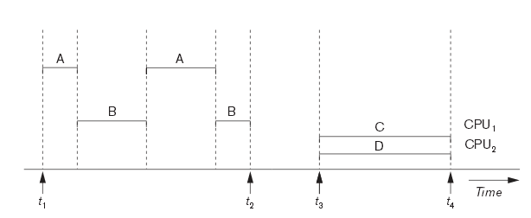
Interleaved processing( A & B ) versus parallel processing( C & D ) of concurrent transactions

Slide 5
1-Introduction to Transaction Processing
A Transaction: logical unit of database processing that includes one or more access operations (read -retrieval, write - insert or update, delete).
A transaction (set of operations) may be stand-alone specified in a high level language like SQL submitted interactively, or may be embedded within a program.
Transaction boundaries: Begin and End transaction.
An application program may contain several transactions separated by the Begin and End transaction boundaries.

Slide 6
1-Introduction to Transaction Processing
SIMPLE MODEL OF A DATABASE (for purposes of discussing transactions):
A database - collection of named data items
Granularity of data –(means size of data item) a field, a record , or a whole disk block (Concepts are independent of granularity)
Basic operations are read and write
read_item(X): Reads a database item named X into a program variable. To simplify our notation, we assume that the program variable is also named X.
write_item(X): Writes the value of program variable X into the database item named X.

Slide 7
1-Introduction to Transaction Processing
READ AND WRITE OPERATIONS:
Basic unit of data transfer from the disk to the computer main memory is one block. In general, a data item (what is read or written) will be the field of some record in the database, although it may be a larger unit such as a record or even a whole block.
read_item(X) command includes the following steps:
Find the address of the disk block that contains item X.
Copy that disk block into a buffer in main memory (if that disk block is not already in some main memory buffer).
Copy item X from the buffer to the program variable named X.

Slide 8
1-Introduction to Transaction Processing
READ AND WRITE OPERATIONS (cont.):
write_item(X) command includes the following steps:
Find the address of the disk block that contains item X.
Copy that disk block into a buffer in main memory (if that disk block is not already in some main memory buffer).
Copy item X from the program variable named X into its correct location in the buffer.
Store the updated block from the buffer back to disk (either immediately or at some later point in time).

Slide 9
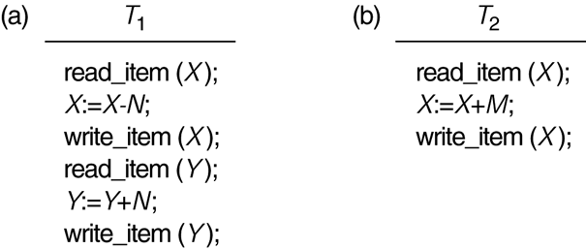
Two sample transactions. (a) Transaction T₁. (b) Transaction T₂.

Slide 10
Figure 17.2a shows a transaction T1 that transfers N reservations from one flight whose number of reserved seats is stored in the database item named X to another flight whose number of reserved seats is stored in the database item named Y.
Figure 17.2b shows a simpler transaction T2 that just reserves M seats on the first flight (X) referenced in transactionT2.
For example, if X = 80 at the start (originally there were 80 reservations on the flight), N =5 (T1 transfers 5 seat reservations from the flight corresponding to X to the flight corresponding to Y), and M = 4 (T2 reserves 4 seats on X),

Slide 11
1-Introduction to Transaction Processing
Why Concurrency Control is needed:
The Lost Update Problem.
This occurs when two transactions that access the same database items have their operations interleaved in a way that makes the value of some database item incorrect.

Slide 12
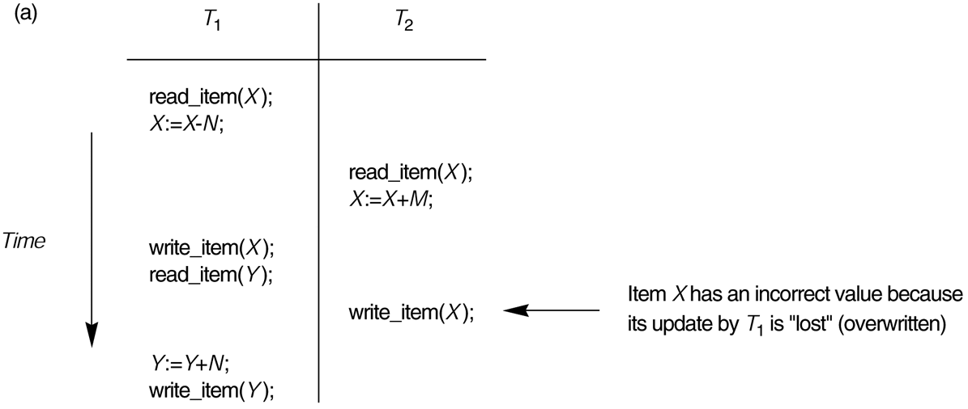
Some problems that occur when concurrent execution is uncontrolled. (a) The lost update problem.
X = 84 because the update in T1 that removed the five seats from X was lost.

Slide 13
1-Introduction to Transaction Processing
Why Concurrency Control is needed:
The Temporary Update (or Dirty Read) Problem.
This occurs when one transaction updates a database item and then the transaction fails for some reason. The updated item is accessed by another transaction before it is changed back to its original value.

Slide 14
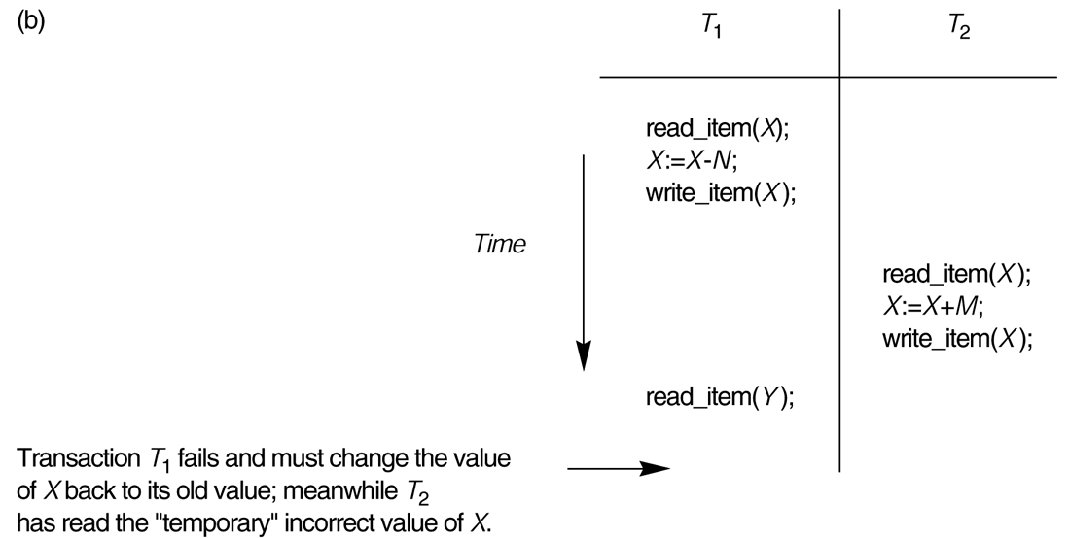
Some problems that occur when concurrent execution is uncontrolled. (b) The temporary update problem.

Slide 15
Figure 17.3b shows an example where T1 updates item X and then fails before completion, so the system must change X back to its original value. Before it can do so, however, transaction T2 reads the "temporary" value of X, which will not be recorded permanently in the database because of the failure of T1-The value of item X that is read by T2 is called dirty data, because it has been created by a transaction that has not completed and committed yet; hence, this problem is also known as the dirty read problem.

Slide 16
1-Introduction to Transaction Processing
Why Concurrency Control is needed (cont.):
The Incorrect Summary Problem .
If one transaction is calculating an aggregate summary function on a number of records while other transactions are updating some of these records, the aggregate function may calculate some values before they are updated and others after they are updated.

Slide 17
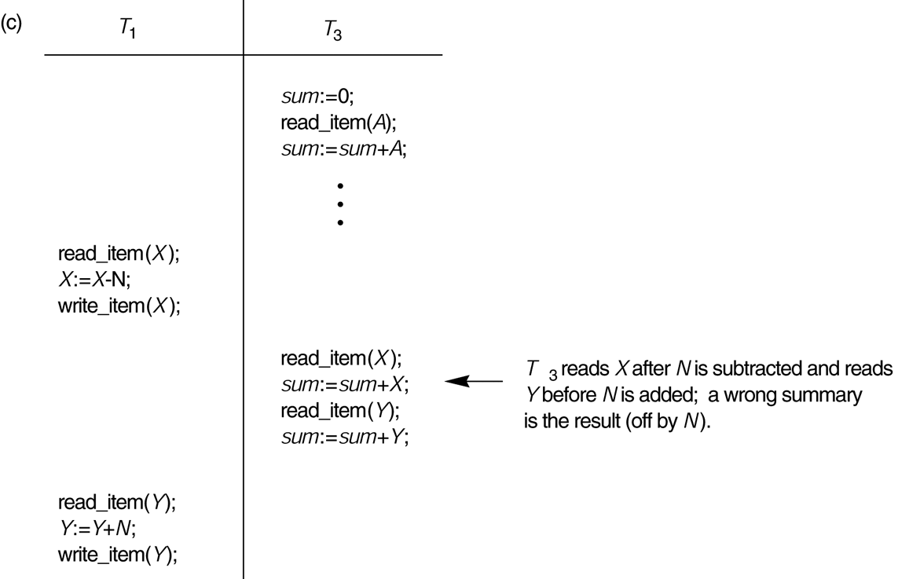
Some problems that occur when concurrent execution is uncontrolled. (c) The incorrect summary problem.

Slide 18
1-Introduction to Transaction Processing
Why recovery is needed:
(What causes a Transaction to fail)
1. A computer failure (system crash): A hardware or software error occurs in the computer system during transaction execution. If the hardware crashes, the contents of the computer’s internal memory may be lost.
2. A transaction or system error : Some operation in the transaction may cause it to fail, such as integer overflow or division by zero. Transaction failure may also occur because of erroneous parameter values or because of a logical programming error. In addition, the user may interrupt the transaction during its execution.

Slide 19
1-Introduction to Transaction Processing
3. Local errors or exception conditions detected by the transaction:
certain conditions necessitate cancellation of the transaction. For example, data for the transaction may not be found. A condition, such as insufficient account balance in a banking database, may cause a transaction, such as a fund withdrawal from that account, to be canceled.
4. Concurrency control enforcement: The concurrency control method may decide to abort the transaction, to be restarted later, because it violates serializability or because several transactions are in a state of deadlock.

Slide 20
1-Introduction to Transaction Processing
5. Disk failure: Some disk blocks may lose their data because of a read or write malfunction or because of a disk read/write head crash. This may happen during a read or a write operation of the transaction.
6. Physical problems and catastrophes: This refers to an endless list of problems that includes power or air-conditioning failure, fire, theft, sabotage, overwriting disks or tapes by mistake, and mounting of a wrong tape by the operator.

Slide 21
2-Transaction and System Concepts
A transaction is an atomic unit of work that is either completed in its entirety or not done at all. For recovery purposes, the system needs to keep track of when the transaction starts, terminates, and commits or aborts.
Transaction states:
Active state
Partially committed state
Committed state
Failed state
Terminated State

Slide 22
2-Transaction and System Concepts
Recovery manager keeps track of the following operations:
begin_transaction: This marks the beginning of transaction execution.
read or write: These specify read or write operations on the database items that are executed as part of a transaction.
end_transaction: This specifies that read and write transaction operations have ended and marks the end limit of transaction execution. At this point it may be necessary to check whether the changes introduced by the transaction can be permanently applied to the database or whether the transaction has to be aborted because it violates concurrency control or for some other reason.

Slide 23
2-Transaction and System Concepts
commit_transaction: This signals a successful end of the transaction so that any changes (updates) executed by the transaction can be safely committed to the database and will not be undone.
rollback (or abort): This signals that the transaction has ended unsuccessfully, so that any changes or effects that the transaction may have applied to the database must be undone.

Slide 24
2-Transaction and System Concepts
undo: Similar to rollback except that it applies to a single operation rather than to a whole transaction.
redo: This specifies that certain transaction operations must be redone to ensure that all the operations of a committed transaction have been applied successfully to the database.

Slide 25
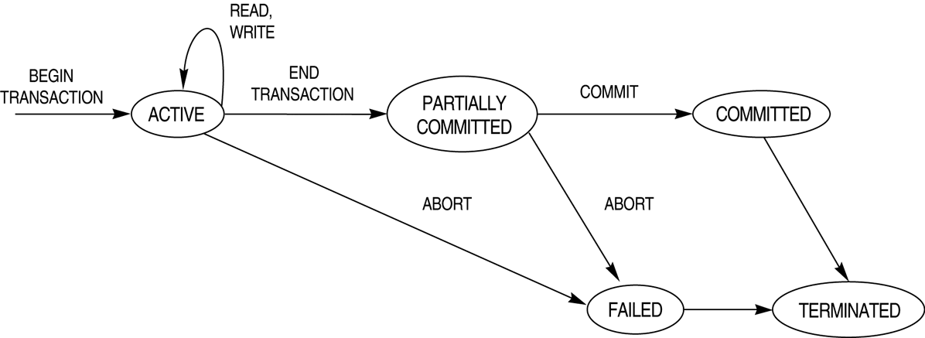
State transition diagram illustrating the states for transaction execution.

Slide 26
2-Transaction and System Concepts
The System Log
Log or Journal : The log keeps track of all transaction operations that affect the values of database items. This information may be needed to permit recovery from transaction failures. The log is kept on disk, so it is not affected by any type of failure except for disk or catastrophic failure. In addition, the log is periodically backed up to archival storage (tape) to guard against such catastrophic failures.
in the following discussion refers to a unique transaction-id that is generated automatically by the system and is used to identify each transaction:

Slide 27
2-Transaction and System Concepts
Types of log record:
[start_transaction,T]: Records that transaction T has started execution.
[write_item,T,X,old_value,new_value]: Records that transaction T has changed the value of database item X from old_value to new_value.
[read_item,T,X]: Records that transaction T has read the value of database item X.
[commit,T]: Records that transaction T has completed successfully, and affirms that its effect can be committed (recorded permanently) to the database.
[abort,T]: Records that transaction T has been aborted.

Slide 28
2-Transaction and System Concepts
Recovery using log records:
If the system crashes, we can recover to a consistent database state by examining the log and using one of the techniques.
Because the log contains a record of every write operation that changes the value of some database item, it is possible to undo the effect of these write operations of a transaction T by tracing backward through the log and resetting all items changed by a write operation of T to their old_values.
We can also redo the effect of the write operations of a transaction T by tracing forward through the log and setting all items changed by a write operation of T (that did not get done permanently) to their new_values.

Slide 29
2-Transaction and System Concepts
Commit Point of a Transaction:
Definition: A transaction T reaches its commit point when all its operations that access the database have been executed successfully and the effect of all the transaction operations on the database has been recorded in the log. Beyond the commit point, the transaction is said to be committed, and its effect is assumed to be permanently recorded in the database. The transaction then writes an entry [commit,T] into the log.
Roll Back of transactions: Needed for transactions that have a [start_transaction,T] entry into the log but no commit entry [commit,T] into the log.

Slide 30
2-Transaction and System Concepts
Redoing transactions: Transactions that have written their commit entry in the log must also have recorded all their write operations in the log; otherwise they would not be committed, so their effect on the database can be redone from the log entries. (Notice that the log file must be kept on disk. At the time of a system crash, only the log entries that have been written back to disk are considered in the recovery process because the contents of main memory may be lost.)
Force writing a log: before a transaction reaches its commit point, any portion of the log that has not been written to the disk yet must now be written to the disk. This process is called force-writing the log file before committing a transaction.

Slide 31
3-Desirable Properties of Transactions
ACID properties:
Atomicity: A transaction is an atomic unit of processing; it is either performed in its entirety or not performed at all.
Consistency preservation: A correct execution of the transaction must take the database from one consistent state to another.

Slide 32
3-Desirable Properties of Transactions
Isolation: A transaction should not make its updates visible to other transactions until it is committed; this property, when enforced strictly, solves the temporary update problem and makes cascading rollbacks of transactions unnecessary.
Durability or permanency: Once a transaction changes the database and the changes are committed, these changes must never be lost because of subsequent failure.

Slide 33
4-Characterizing Schedules based on Recoverability
Transaction schedule or history: When transactions are executing concurrently in an interleaved fashion, the order of execution of operations from the various transactions forms what is known as a transaction schedule (or history).
A schedule (or history) S of n transactions T1, T2, ..., Tn :
It is an ordering of the operations of the transactions subject to the constraint that, for each transaction Ti that participates in S, the operations of T1 in S must appear in the same order in which they occur in T1. Note, however, that operations from other transactions Tj can be interleaved with the operations of Ti in S.

Slide 34
4-Characterizing Schedules based on Recoverability
To describe a schedule uses the symbols r, w, c, and a for the operations read_item, write_item, commit and abort, and appends as subscript the transaction id to each operation in the schedule.
For example, the schedule of previous figure which we shall call Sa, can be written as follows:
Sa: r1 (X); r2 (X); w1 (X); r1 (Y); w2 (X); w1 (Y);

Slide 35
4-Characterizing Schedules based on Recoverability
Two operations in the schedule are said to conflict if they satisfy all three of the following conditions:
the belong to different transactions.
they access the same item X.
At least one of the operations is a write_item(X).
For example:
In Sa the operations r1 (X) and w2 (X) conflict.
r1 (X) and w1 (X) do not conflict.
And so on.

Slide 36
4-Characterizing Schedules based on Recoverability
Schedules classified on recoverability:
Recoverable schedule: One where no transaction needs to be rolled back.
A schedule S is recoverable if no transaction T in S commits until all transactions T’ that have written an item that T reads have committed.
S: r1 (X); r2 (X); w1 (X); r1 (Y); w2 (X); c2; w1 (Y); c1;

Slide 37
4-Characterizing Schedules based on Recoverability
Cascadeless schedule: One where every transaction reads only the items that are written by committed transactions.
Schedules requiring cascaded rollback: A schedule in which uncommitted transactions that read an item from a failed transaction must be rolled back.
S: r1(X); w1(X); r2(X); r1(Y); w2(X); w1(Y); a1; a2;
Strict Schedules: A schedule in which a transaction can neither read or write an item X until the last transaction that wrote X has committed.

Slide 38
5-Characterizing Schedules based on Serializability
Serial schedule: A schedule S is serial if, for every transaction T participating in the schedule, all the operations of T are executed consecutively in the schedule. Otherwise, the schedule is called nonserial schedule.
Serializable schedule: A schedule S is serializable if it is equivalent to some serial schedule of the same n transactions.

Slide 39
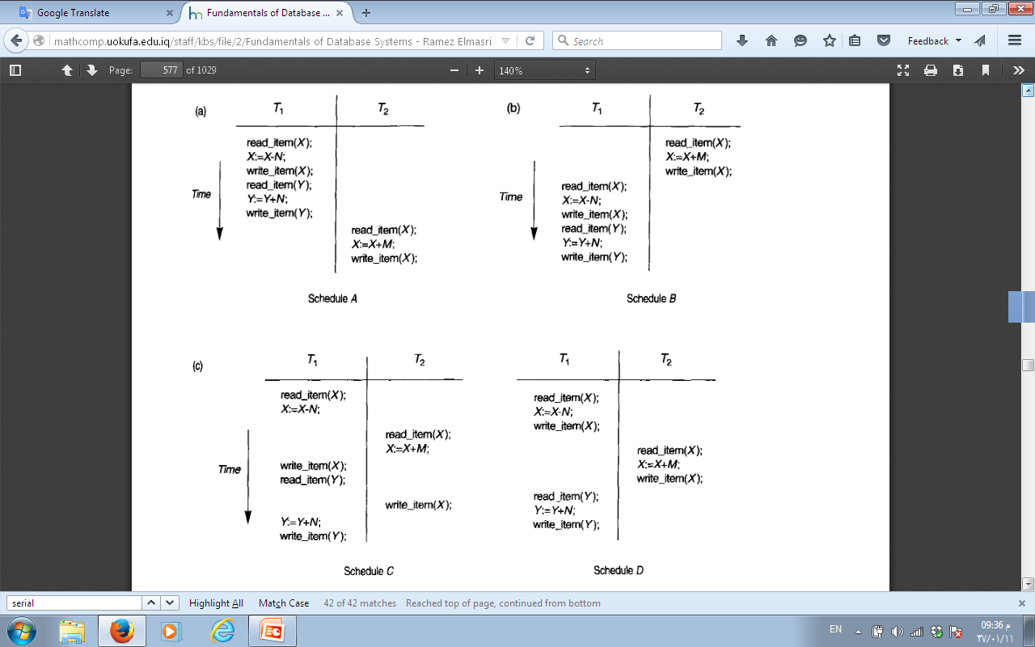

Slide 40
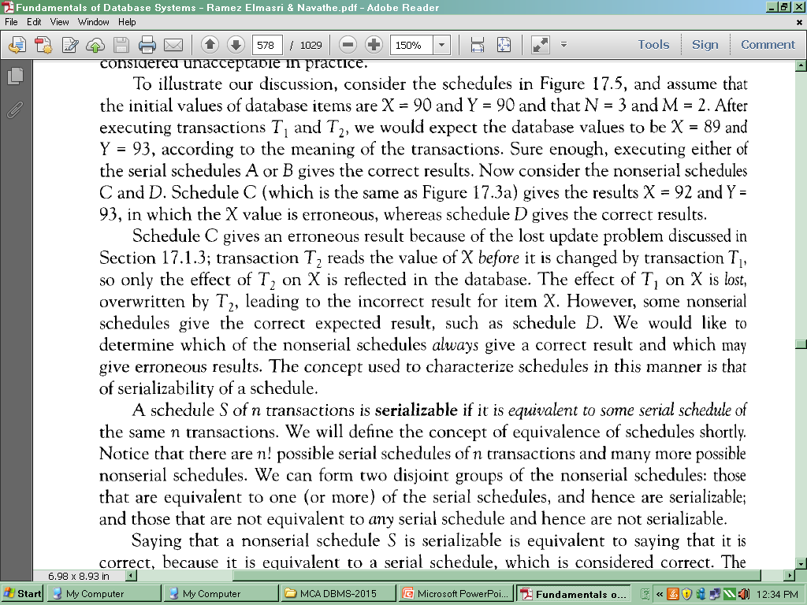

Slide 41
5-Characterizing Schedules based on Serializability
Result equivalent: Two schedules are called result equivalent if they produce the same final state of the database.
Conflict equivalent: Two schedules are said to be conflict equivalent if the order of any two conflicting operations is the same in both schedules.
Conflict serializable: A schedule S is said to be conflict serializable if it is conflict equivalent to some serial schedule S’.

Slide 42
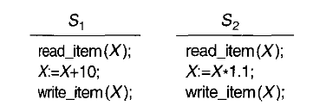
Two schedules that are result equivalent for the initial value of X=100 but are not result equivalent in general

Slide 43
5-Characterizing Schedules based on Serializability
Testing conflict serializability of a Schedule S
For each transaction Ti participating in schedule S,create a node labeled Ti in the precedence graph.
For each case in S where Tj executes a read_item(X) after Ti executes a write_item(X), create an edge (Tj→Ti) in the precedence graph.
For each case in S where Tj executes a write_item(X) after Ti executes a read_itern (X) ,create an edge (Tj→Ti) in the precedence graph.
For each case in S where Tj executes a write_item(X) after Ti executes a write_item(X), create an edge (Tj→Ti) in the precedence graph.
The schedule S is serializable if and only if the precedence graph has no cycles.

Slide 44
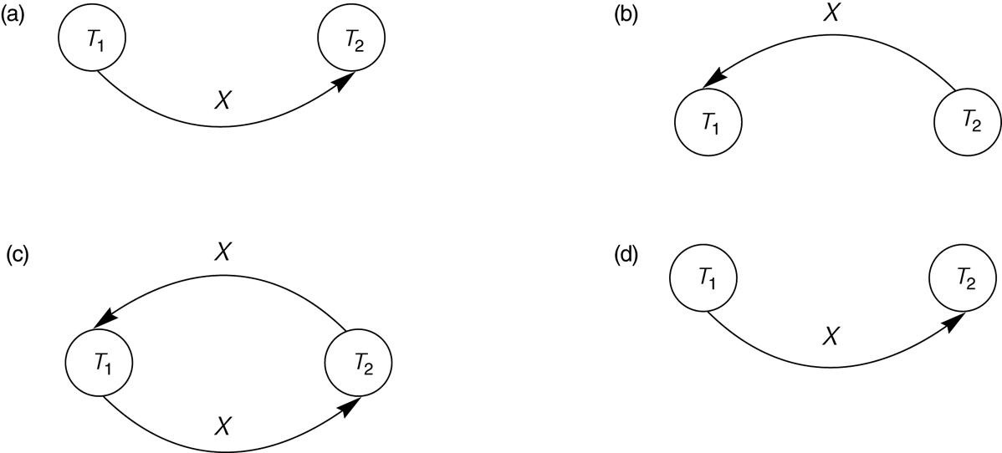
Constructing the precedence graphs for schedules A and D from to test for conflict serializability. (a) Precedence graph for serial schedule A. (b) Precedence graph for serial schedule B. (c) Precedence graph for schedule C (not serializable). (d) Precedence graph for schedule D (serializable, equivalent to schedule A).

Slide 45
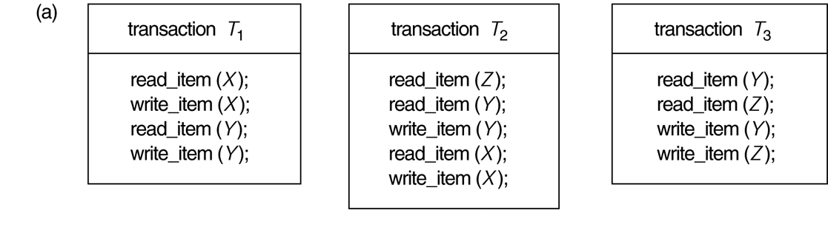
Another example of serializability testing. (a) The READ and WRITE operations of three transactions T₁, T₂, and T₃.

Slide 46
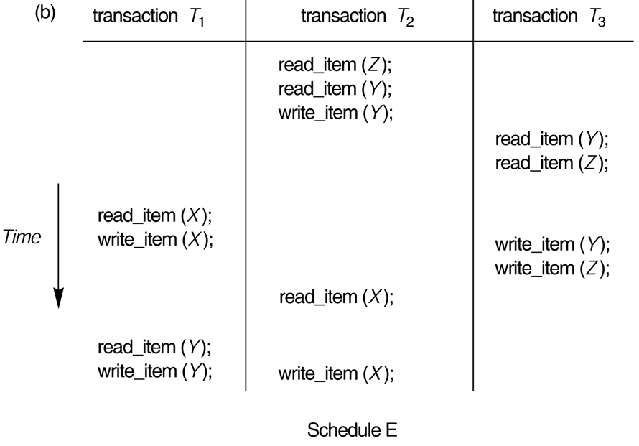
(continued) Another example of serializability testing. (b) Schedule E.

Slide 47
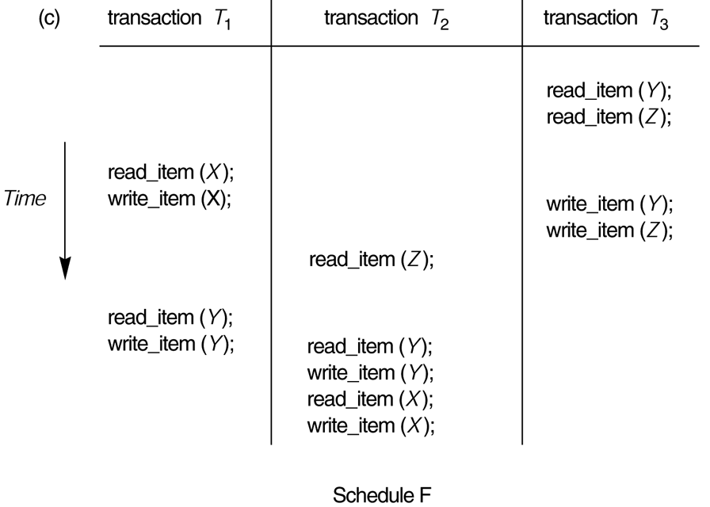
(continued) Another example of serializability testing. (c) Schedule F.

Slide 48
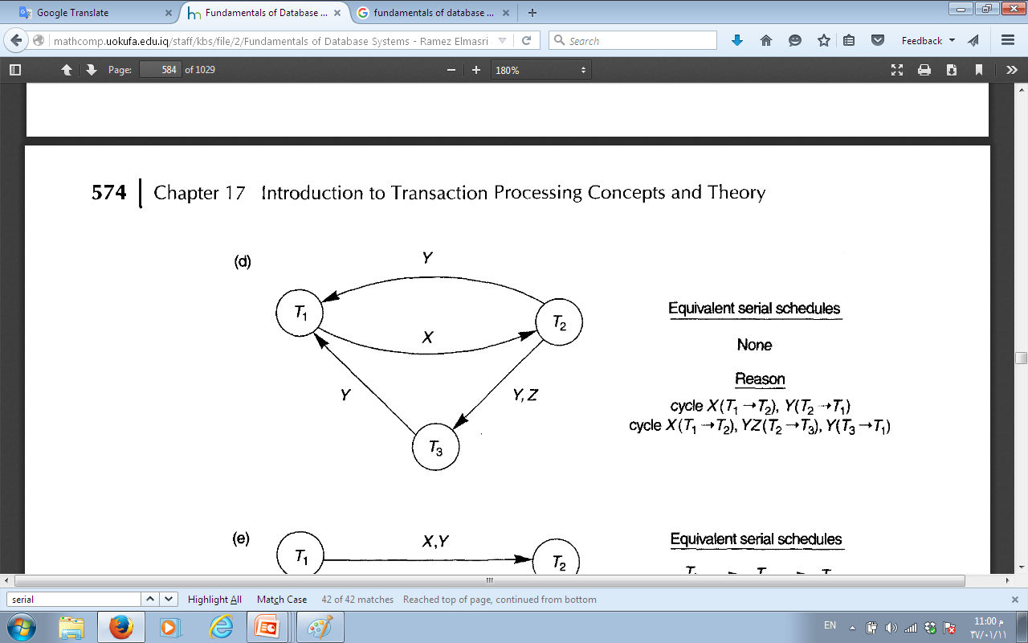
Precedence graph for schedule E

Slide 49
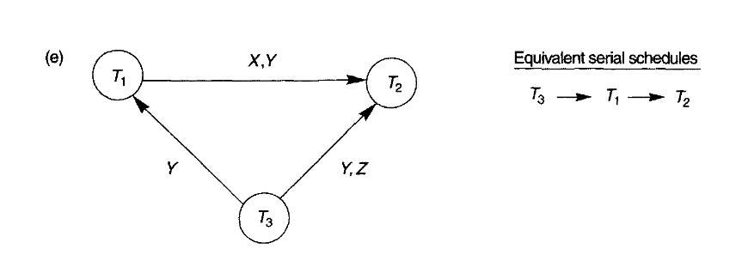
Precedence graph for schedule F

